Slide 1
Employee Data Analysis
SQL Script

Slide 2
Objective:
The database design helps to calculate the monthly payroll of each employee efficiently.

Slide 3
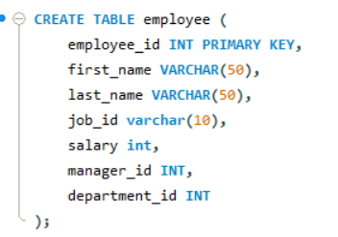
Write a query to create an employee table with the fields employee id, first name, last name, job id, salary, manager id, and department id.

Slide 4
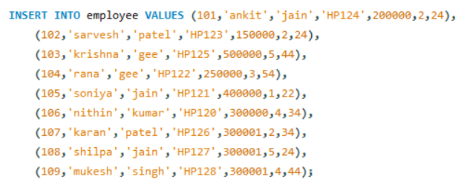
Write a query to insert values into the employee table.

Slide 5
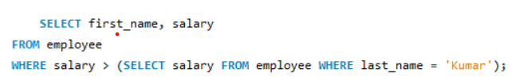
Write a query to find the first name and salary of the employee whose salary is higher than the employee with the last name Kumar from the employee table.

Slide 6

Write a query to display the employee id and last name of the employee whose salary is greater than the average salary from the employee table.

Slide 7
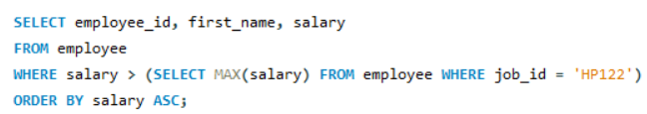
Write a query to display the employee id, first name, and salary of the employees who earn a salary that is higher than the salary of all the shipping clerks (JOB_ID = HP122). Sort the results of the salary in ascending order.

Slide 8
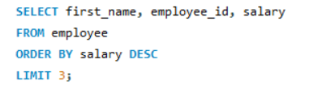
Write a query to display the first name, employee id, and salary of the first three employees with highest salaries.

Slide 9
THANK YOU

